Slide 1
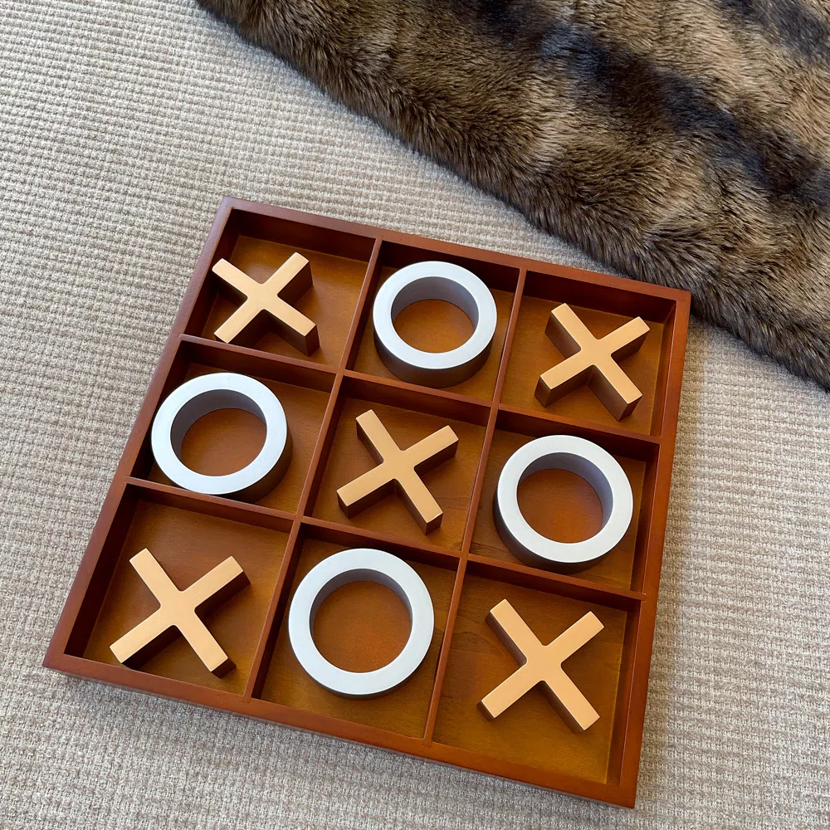
TIC-TAC- TOE
NAME : KOLA YAMINI
MICRO IT PROJECT

Slide 2
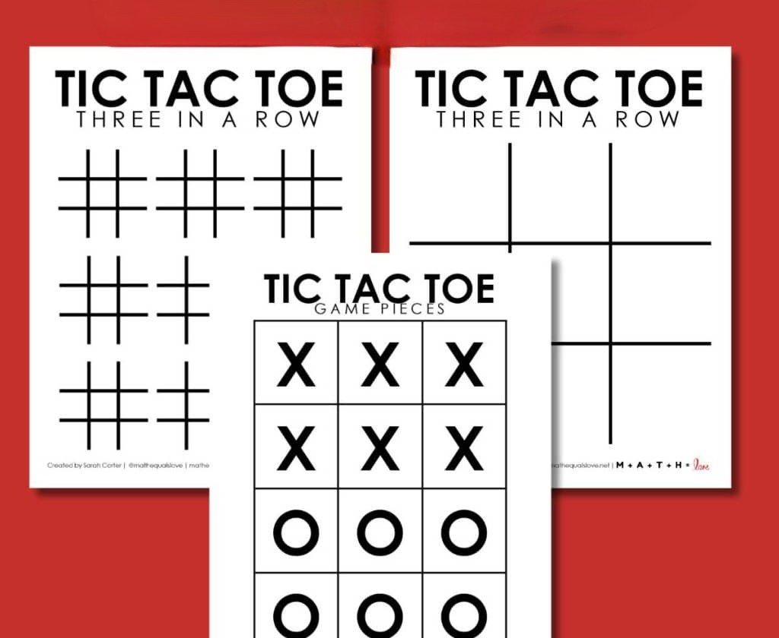
introduction
Tic Tac Toe (also known as Noughts and Crosses) is a classic two-player game played on a 3x3 grid. Players take turns marking a space with either an "X" or an "O". The first player to align three of their symbols in a row—horizontally, vertically, or diagonally—wins the game. If all spaces are filled without a winner, the game ends in a draw.

Slide 3
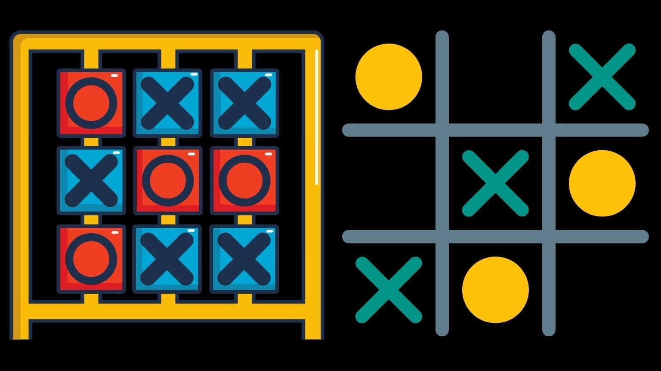
Objective of the project
The objective of this project is to design and implement a simple, interactive Tic Tac Toe game using Python. The project aims to demonstrate fundamental programming concepts such as control structures, functions, loops, lists, and user input handling. The game will allow two players to take turns, display the game board, check for winning conditions, and declare the result (win or draw). This project also serves to enhance understanding of basic logic building and user interface through a text-based environment.

Slide 4
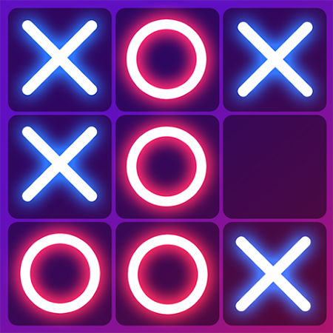
How to play
The game is played on a 3x3 grid.
There are two players: one uses X, and the other uses O.
Players take turns placing their symbol (X or O) in an empty square.
The goal is to be the first to get three of your marks in a row, which can be:
Horizontally
Vertically
Diagonally

Slide 5
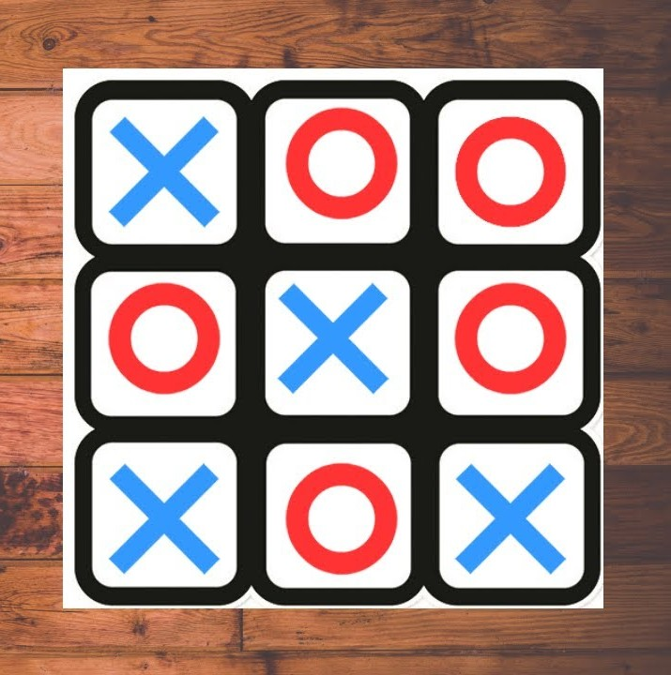
Tools used
Python Standard Library No external libraries are required for a basic text-based game.
Text Editor / IDE Tools like VS Code, PyCharm, or even IDLE help write and run the code efficiently.
Terminal / Command Line For running the game if it’s a console-based program.

Slide 6
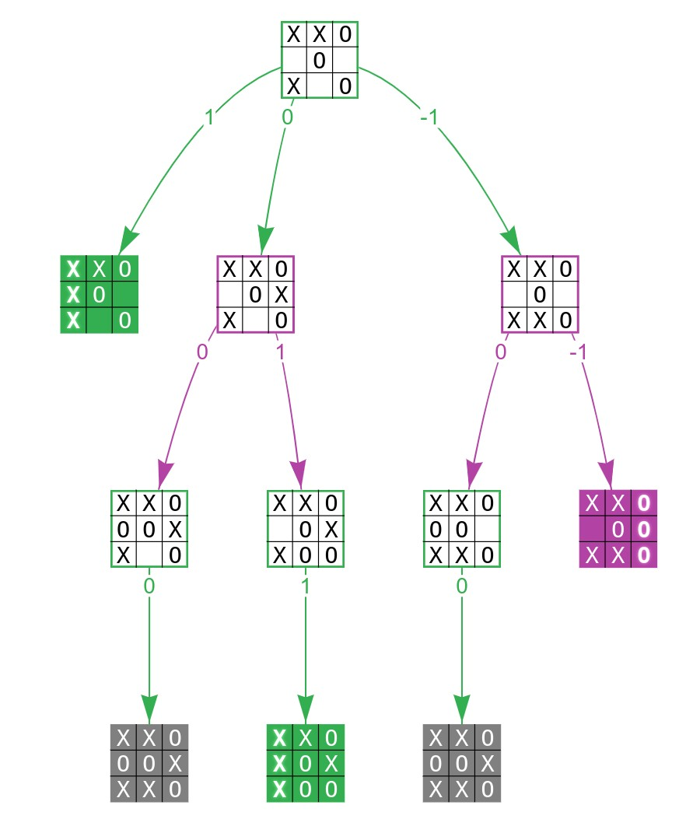


Flow chart
Clean and minimalist design start/restart button
Player turn display
Result pop-up or message after win/draw

Slide 7
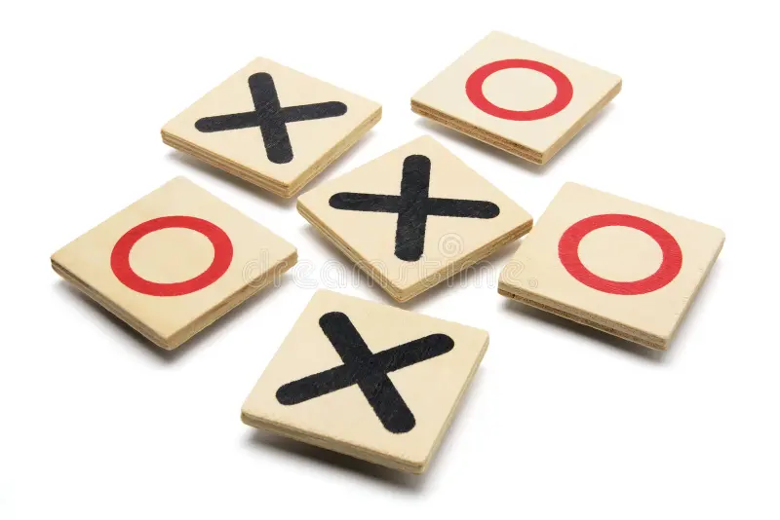
Key components
Game Board – A 3x3 grid represented as a list of lists or a simple list.
Player Input – Alternating turns between two players (X and O).
Move Validation – Ensure players can only move in empty spots.
Win Checking – Determine if a player has won or if it's a draw.
Game Loop – Continue playing until the game ends.

Slide 8
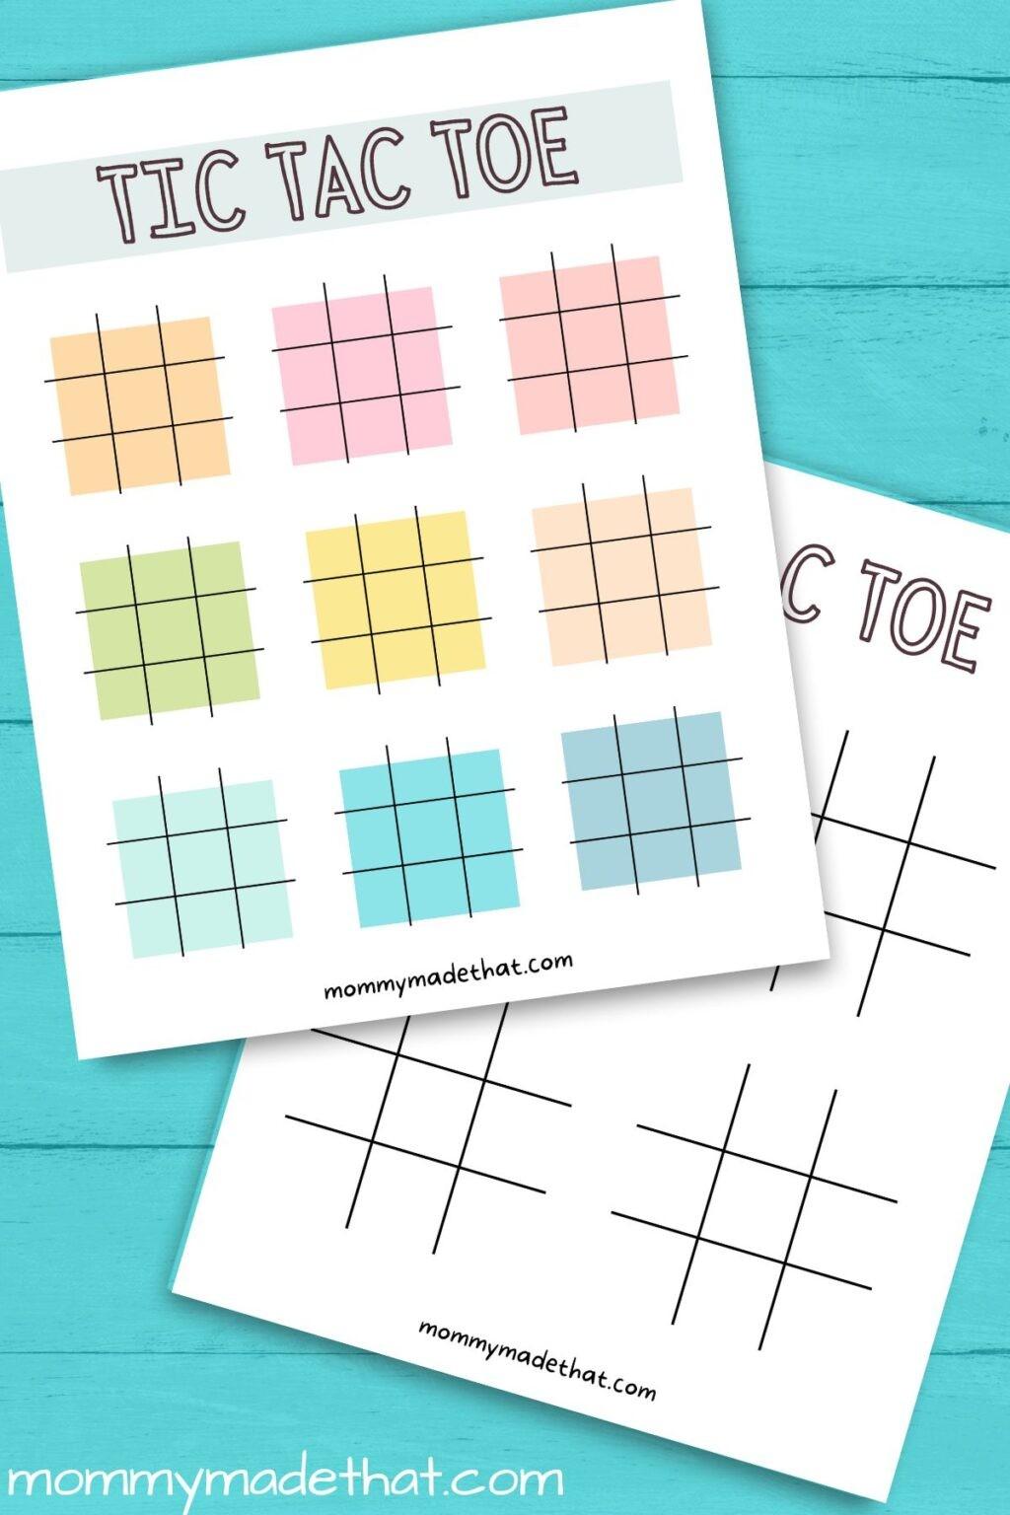
Challenges faced
Game Board Representation
Input Validation
Turn Management
Draw Condition
Win Condition Logic
Replay Option

Slide 9
Learning outcomes
Faced real challenges and developed solutions, improving analytical and critical thinking skills.
Gained experience in managing tasks within deadlines and prioritizing work effectively.
Enhanced verbal and written communication through presentations, meetings, and email correspondence.
Learned to accept constructive feedback and use it to improve performance and skills.

Slide 10

Future scope
Our project will be able to implement in future after making some changes and modifications as we make our project at a very low level. So the modifications that can be done in our project are :-
In future one change can be done by adding the fingerprints of the persons of which the address is entered And One more major change which can be done in this project is that to add the snaps of the person of which the address is entered.

Slide 11

conclusion
This Tic Tac Toe project helped me understand basic programming concepts like loops, conditions, functions, and user input. I learned how to build game logic and handle different scenarios like winning, losing, and drawing. This project improved my coding skills and gave me confidence to work on more complex programs in the future.

